Slide 1
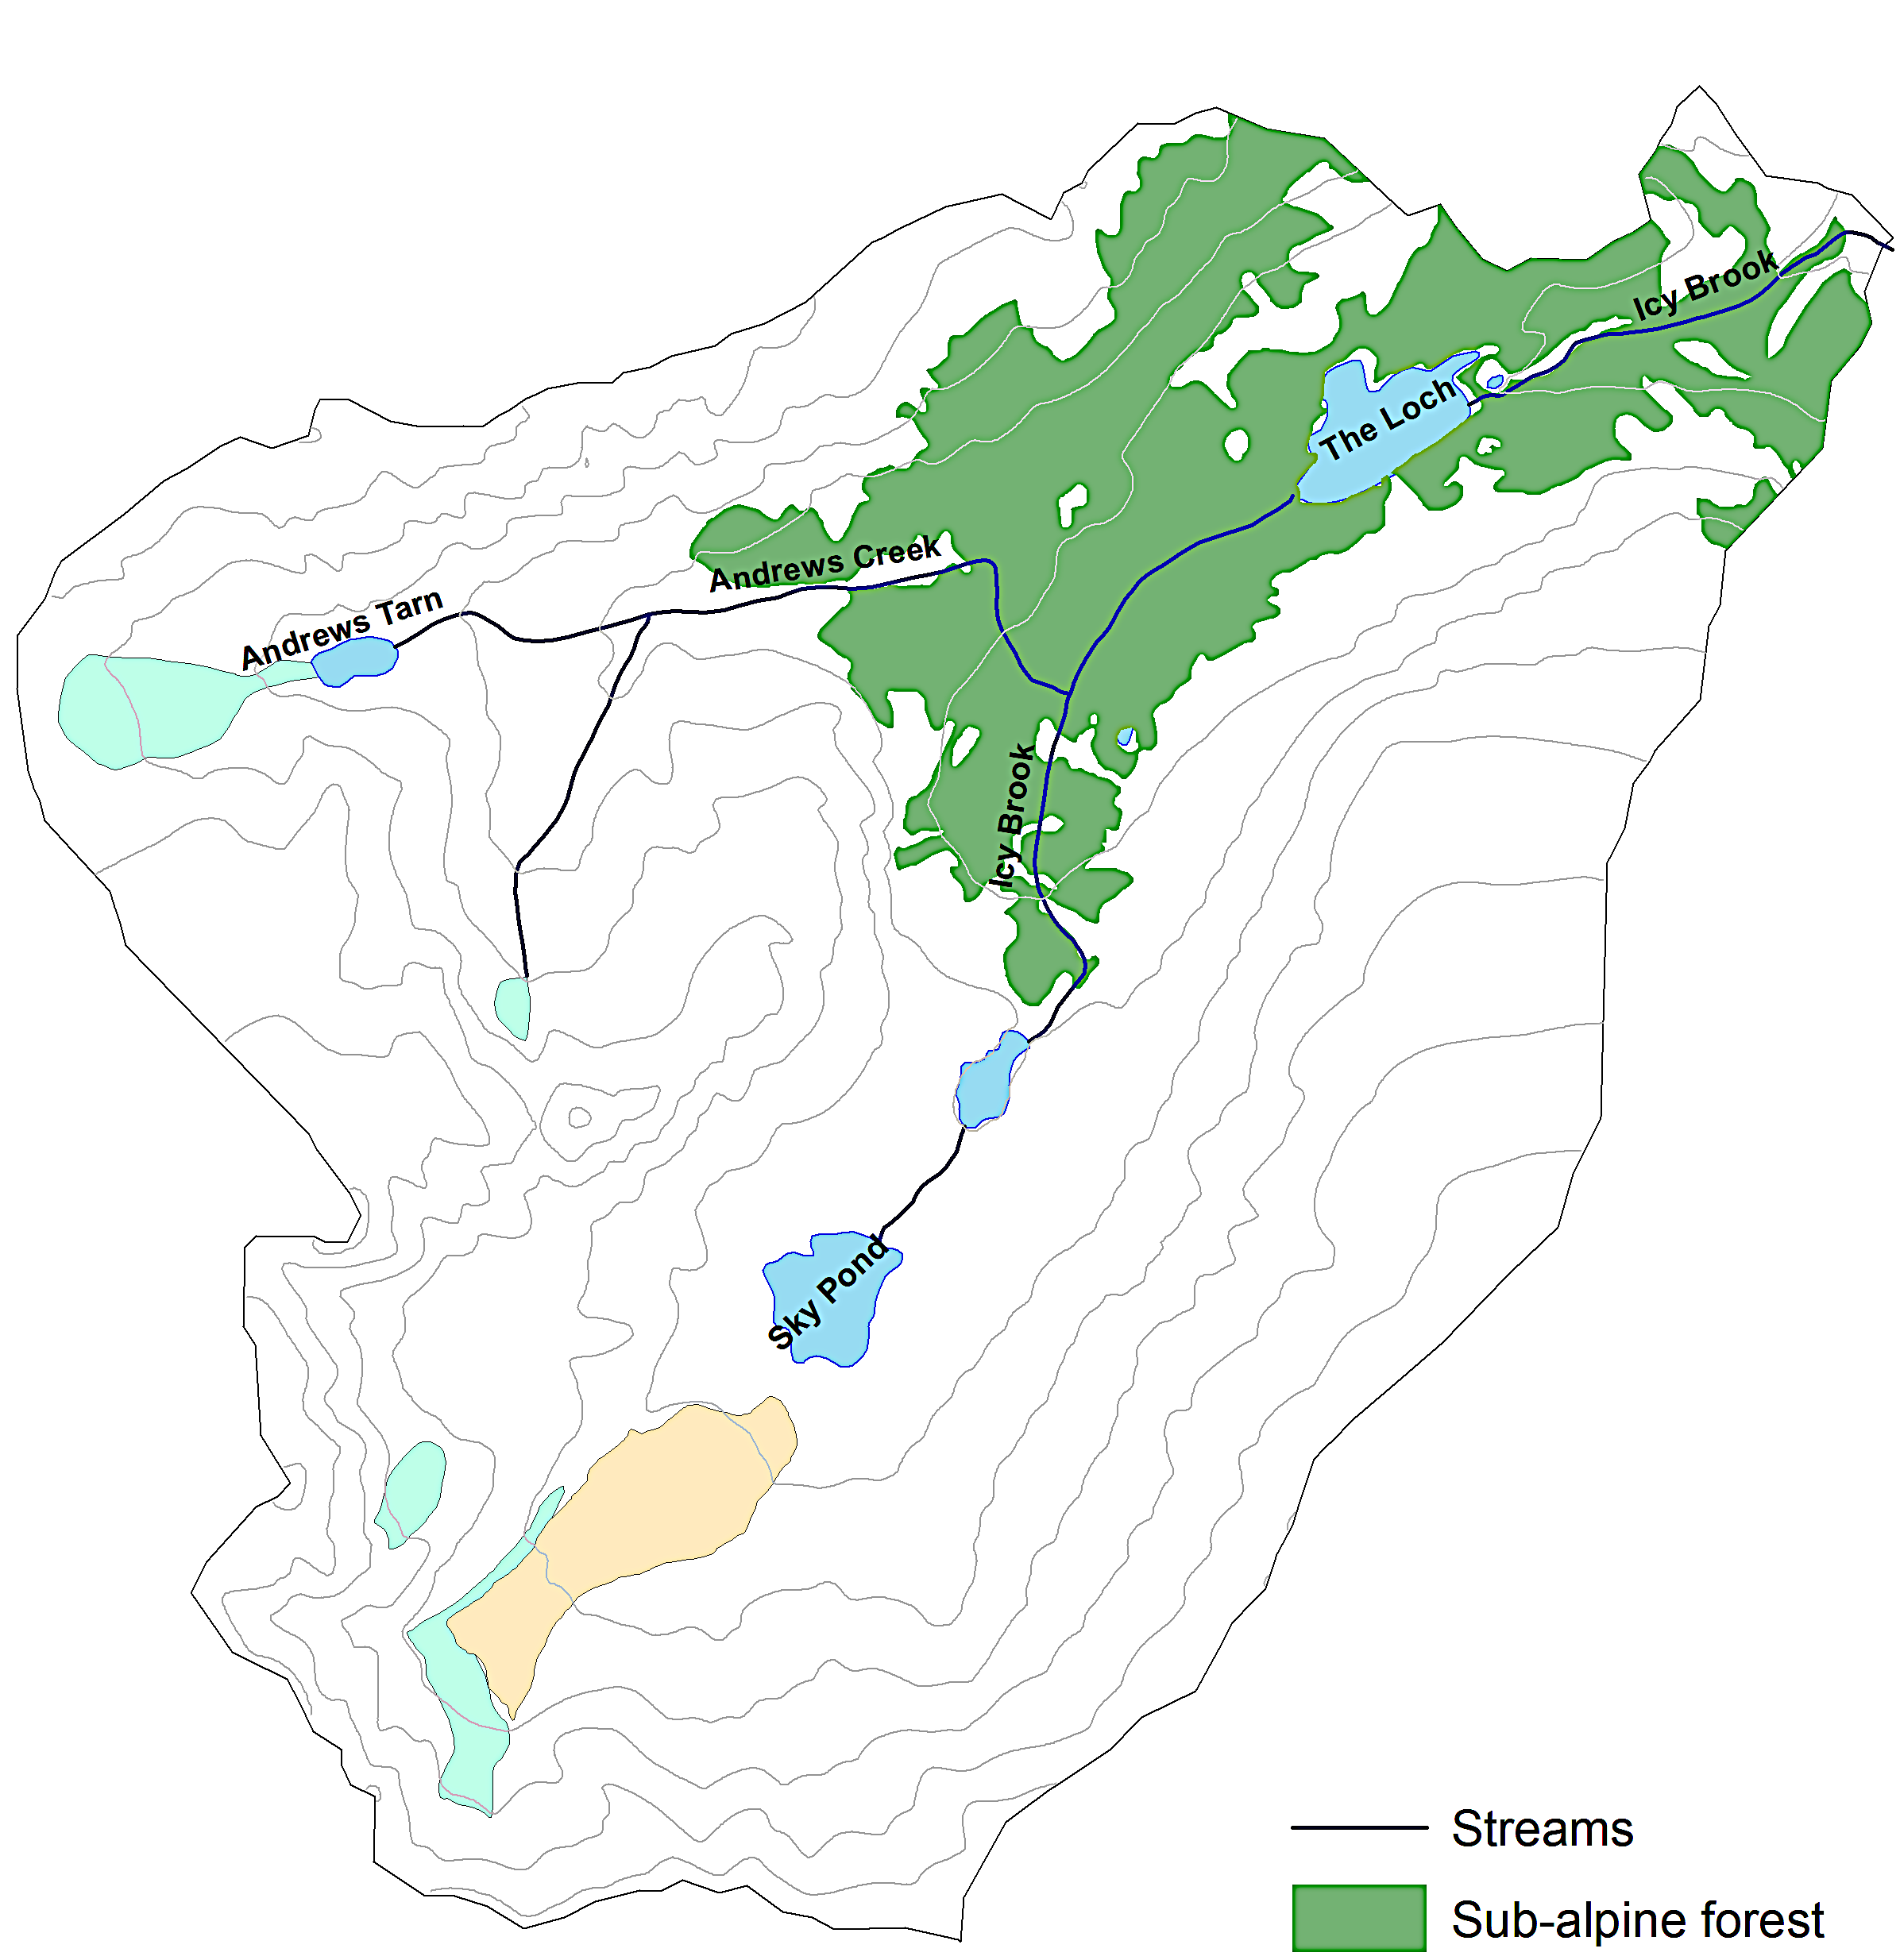
Loch Vale Watershed
LB6
LB5
The Loch
LB3
Andrew’s
Glacier
Andrew’s Creek
LB1
Buoy location
z_{max} = 5m
Icy Brook
LB4
SB5
Sky
Pond
SB4
Taylor
Glacier
SB1
SB2
SB3
Buoy location
z_{max} = 7m

